Slide 1
Introduction to Python
Premanand S

Slide 2
Introduction
General Purpose
High Level Programming Language
Dynamically-typed
Named after Monty Python’s Flying Circus
Guido Van Rossum
1991

Slide 3
Importance
Works in different platform / OS
Syntax is simple like English
Few lines of code
New line means end of the command
Runs in interpreter system
.py or .ipynb

Slide 4
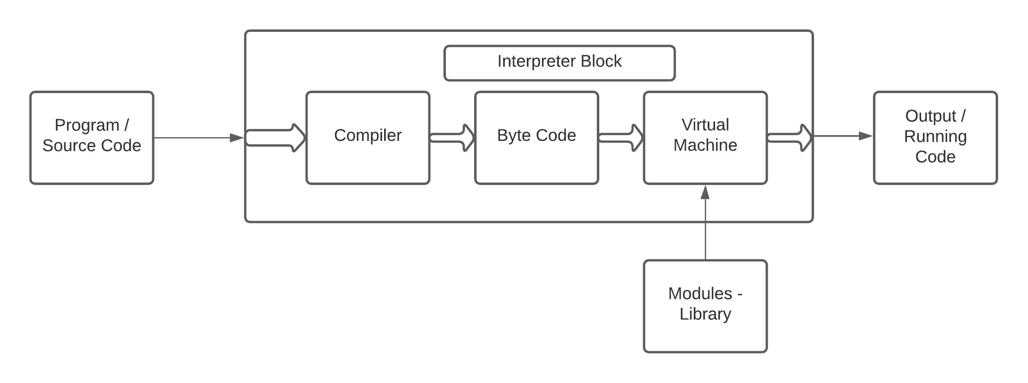
Architecture & Working
Read – Evaluate – Print – Loop
Lexing – Line code to Token
Parsing – Token to structure (Abstract Syntax Tree)
Compiling - Abstract Syntax Tree to Code objects
Interpreting – Executes each object

Slide 5
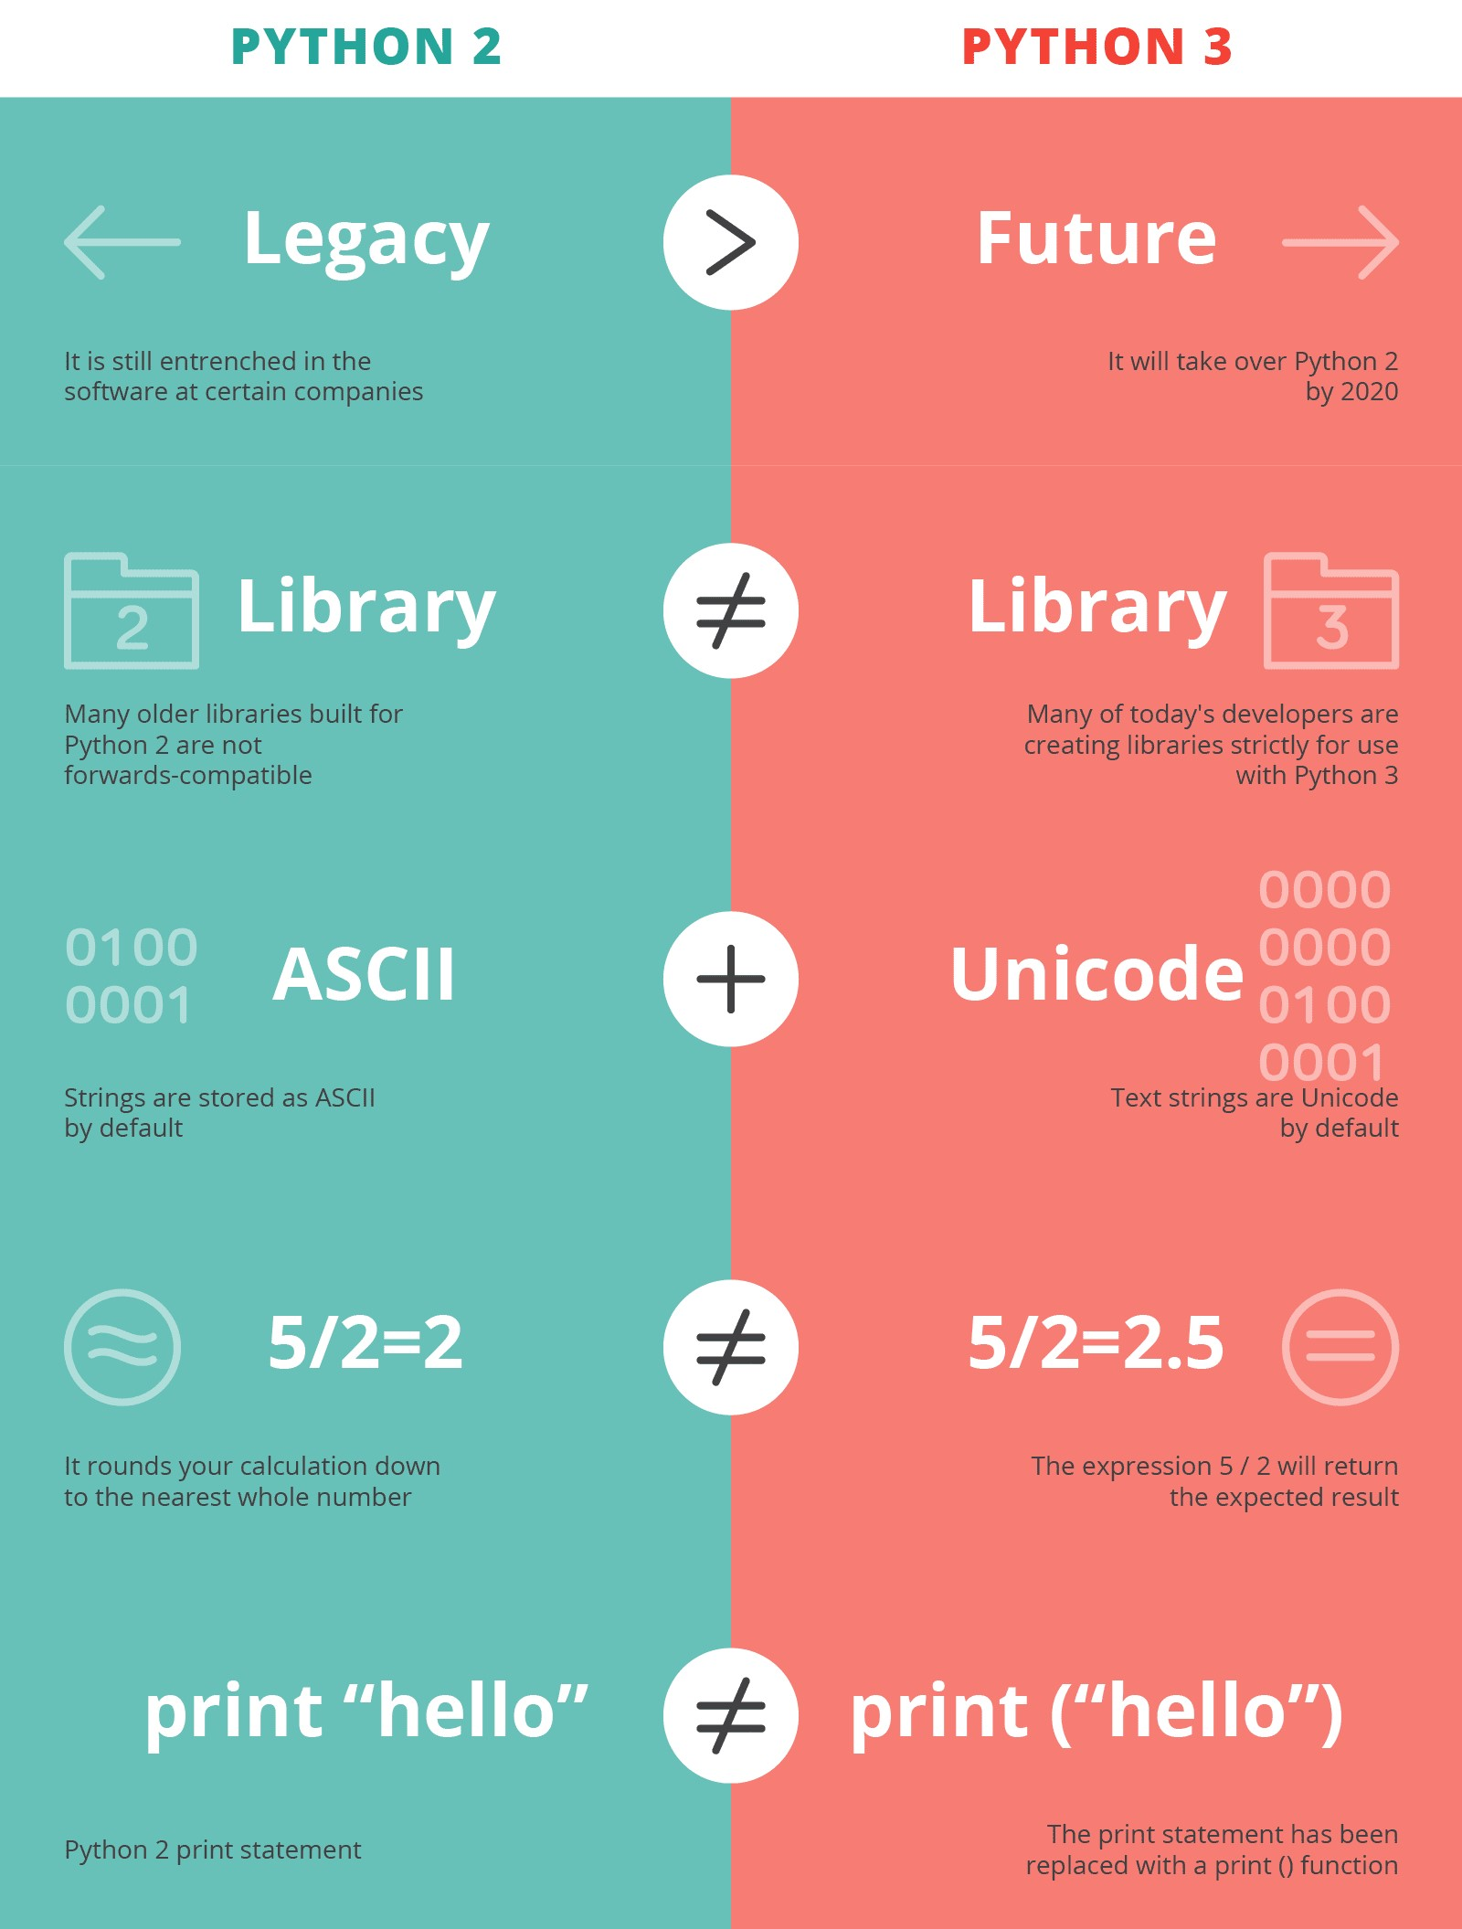
Version difference
Python 2.0 – Oct 16, 2002
Python 3.0 – Dec 3, 2008

Slide 6
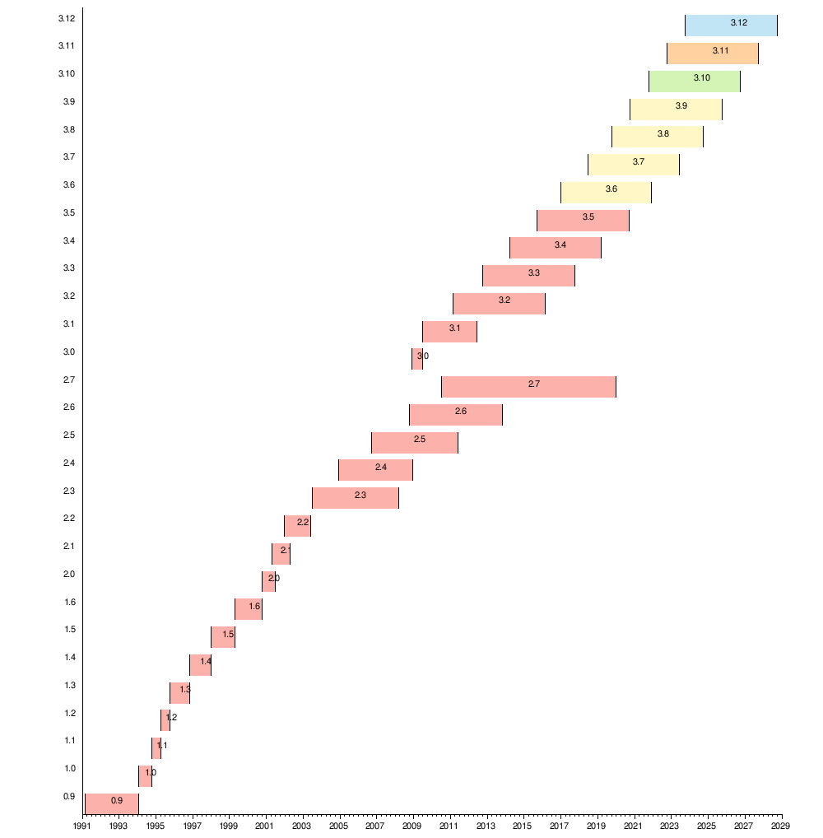
Python - Future

Slide 7
Fun facts
Hobby project
The name Python?
Python overtakes French in school, UK
Flavors of Python – Cpython, Jpython, Micro Python,
Ruby Python, Brython
Tech giants
Multiple assignments in a single line
Import antigravity

Slide 8
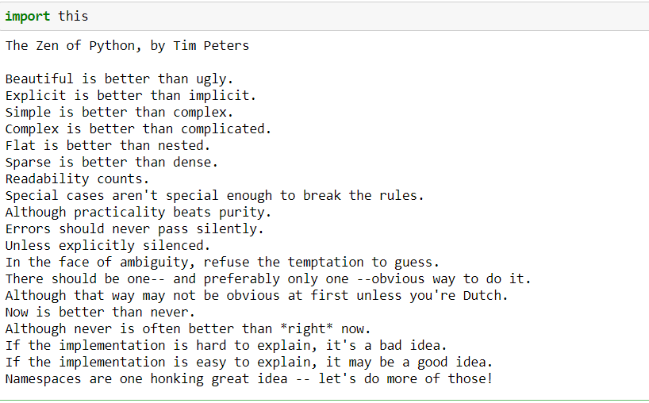
Poetry - Python

Slide 9
Download!
https://www.python.org/
IDE - Coding tool which allows you to write, test, and debug your code in an easier way

Slide 10
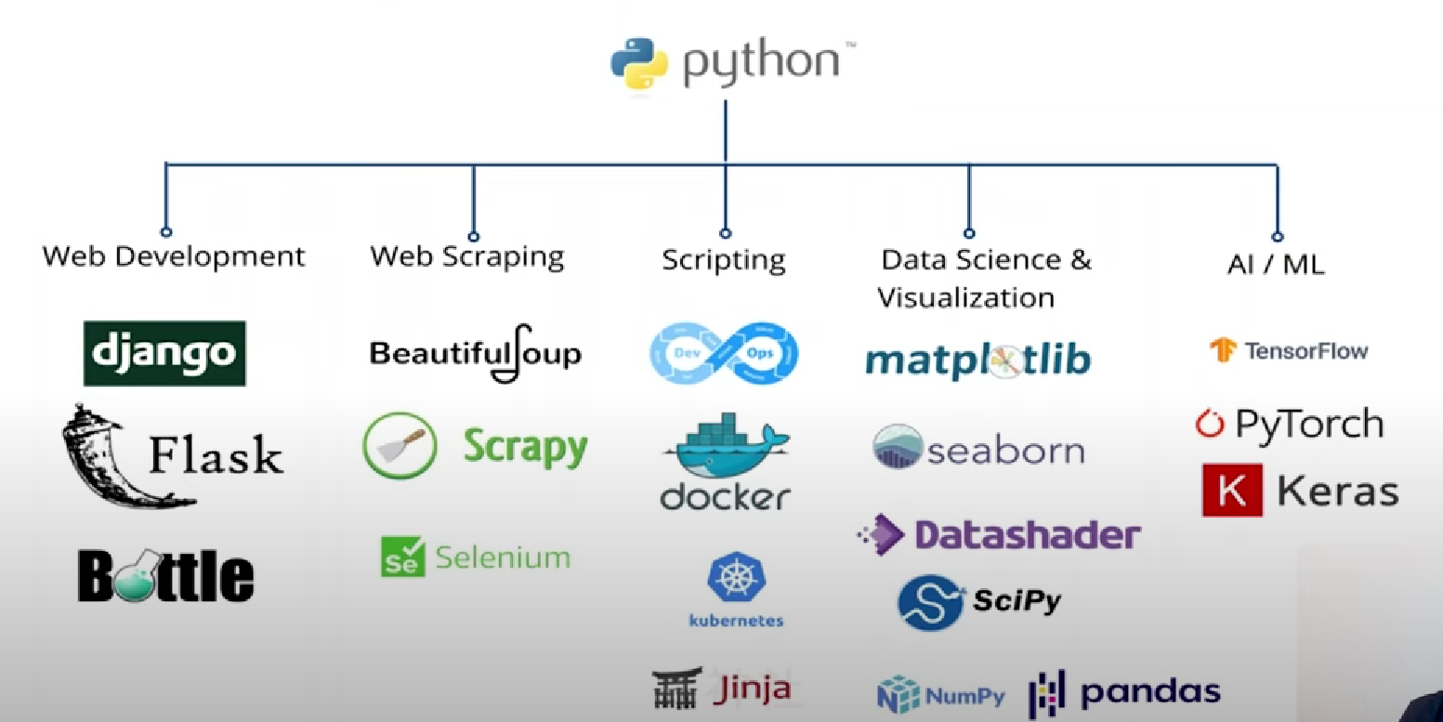
Python with Data Science

